Slide 1




NEXT GEN EMPLOYABILITY PROGRAM
Creating a future-ready workforce
Team Members
College Name
Student Name :K.P.LEKHA PRIYADARSHINI
Student ID :au511321104047
KINGSTON ENGINEERING COLLEGE

Slide 2

CAPSTONE PROJECT SHOWCASE
Project Title
Building Bus Reservation System using Python and Django
Abstract | Problem Statement | Project Overview | Proposed Solution | Technology Used | Modelling & Results | Conclusion

Slide 3
Abstract
The bus reservation system is a critical component of modern transportation infrastructure, facilitating efficient and convenient booking processes for passengers and operators alike. This abstract outlines the key features and functionalities of such a system, emphasizing its role in streamlining ticketing, scheduling, and management processes for bus services.
The bus reservation system offers a user-friendly interface accessible through web and mobile platforms, enabling passengers to search for available routes, select preferred departure times, and reserve seats with ease. It integrates advanced algorithms to optimize seat allocation, ensuring maximum occupancy while adhering to safety and regulatory standards. Additionally, the system provides real-time updates on bus schedules, route changes, and cancellations, minimizing inconvenience for passengers and enabling them to make informed travel decisions.
For operators, the bus reservation system offers comprehensive management tools for fleet scheduling, ticket sales tracking, and revenue management. It generates detailed reports and analytics to support strategic decision-making and improve operational efficiency. Moreover, the system incorporates robust security measures to protect sensitive passenger information and prevent fraudulent activities.
Source :

Slide 4
Problem Statement
The existing bus reservation systems often suffer from inefficiencies and limitations that hinder the seamless booking and management of bus tickets. These challenges include outdated interfaces, lack of real-time updates, poor seat allocation algorithms, and inadequate management tools for operators.
As a result, passengers experience difficulties in finding available routes, securing preferred seats, and receiving timely information about schedule changes or cancellations. Operators, on the other hand, struggle with inefficient fleet scheduling, suboptimal revenue management, and inadequate data analytics for informed decision-making.
In light of these challenges, there is a pressing need for a robust and comprehensive bus reservation system that addresses the shortcomings of existing solutions. Such a system should offer a user-friendly interface with advanced search and booking functionalities.
Source :

Slide 5
Project Overview
The Bus Reserve project aims to develop a state-of-the-art bus reservation system that revolutionizes the way passengers book tickets and operators manage their services. This system will incorporate cutting-edge technologies to address existing challenges in the bus reservation domain and provide a seamless and efficient travel experience for all stakeholders.
Objectives:
Design and develop a user-friendly web and mobile interface for passengers to search, book, and manage bus tickets.
Implement advanced seat allocation algorithms to optimize capacity utilization and minimize instances of overbooking.
Integrate real-time communication channels to provide passengers with up-to-date information on schedules, route changes, and cancellations.
Provide operators with comprehensive management tools for fleet scheduling, revenue management, and performance analytics.
Ensure robust security measures to safeguard passenger data and prevent fraudulent activities.
Source :

Slide 6
Proposed Solution
The Bus Reservation System is a comprehensive solution designed to address the challenges faced by both passengers and operators in the bus reservation domain. Leveraging cutting-edge technologies and user-centric design principles, this system offers a seamless and efficient booking experience while empowering operators with advanced management tools.
Key Features:
User-Friendly Interface:
Intuitive web and mobile interfaces with easy navigation and interactive features.
Customizable search filters allowing passengers to find routes based on preferences such as departure time, seat type, and amenities.
Intelligent Seat Allocation:
AI-driven seat allocation algorithms to optimize seating arrangements based on passenger demand, route popularity, and operational constraints.
Dynamic seat maps displaying available seats and facilitating real-time seat selection for passengers.
Source :

Slide 7
Real-Time Updates and Notifications:
Integration of GPS tracking and communication systems to provide passengers with real-time updates on bus locations, estimated arrival times, and any schedule changes.
Instant notifications via SMS or app alerts to inform passengers about delays, cancellations, or alternative routes.
Flexible Booking Options:
Seamless integration with payment gateways enabling secure online transactions and multiple payment methods.
Flexible booking policies allowing passengers to modify or cancel reservations within a specified timeframe, with automated refund processing.
Comprehensive Management Tools:
Dashboard for operators to manage fleet schedules, track ticket sales, and analyze performance metrics.
Advanced analytics features providing insights into passenger demographics, booking trends, and revenue generation opportunities.
Source :

Slide 8
Implementation Strategy:
1.Requirements Gathering:
Conduct market research and stakeholder interviews to identify user needs, pain points, and system requirements.
Define clear objectives and success criteria for the SmartBus Reservation System.
2.Design and Development:
Adopt an agile development approach to iteratively design, develop, and test system features.
Collaborate with UI/UX designers to create intuitive interfaces and wireframes that prioritize user experience.
3.Positive Impact on Transportation Industry:
Setting a new standard for bus reservation systems and contributing to the advancement of the transportation industry as a whole.
Inspiring innovation and competition among other service providers to improve their offerings.
In conclusion, the Bus Reservation System represents a holistic solution that addresses the diverse needs of passengers and operators while leveraging the latest technologies and best practices in user experience design and system architecture. By prioritizing usability, efficiency, and security, this system aims to redefine the bus reservation experience and drive positive outcomes for all stakeholders involved.
Source :

Slide 9


Technology Used
Front-end
Back-end
Source :

Slide 10
Modelling & Results
The bus reservation system was modeled using a combination of relational database management systems (RDBMS) for data storage and a web-based application framework for user interaction.
The database schema included tables for storing information about routes, buses, schedules, seats, passengers, and bookings, with appropriate relationships and constraints to ensure data integrity.
The web application provided an intuitive interface for passengers to search for available routes, select seats, and make reservations securely. The system incorporated real-time updates on schedule changes and seat availability, enhancing the user experience. As a result, the bus reservation system effectively streamlined the booking process, optimized seat utilization, and improved operational efficiency for bus operators, leading to increased customer satisfaction and revenue generation.
Source :

Slide 11
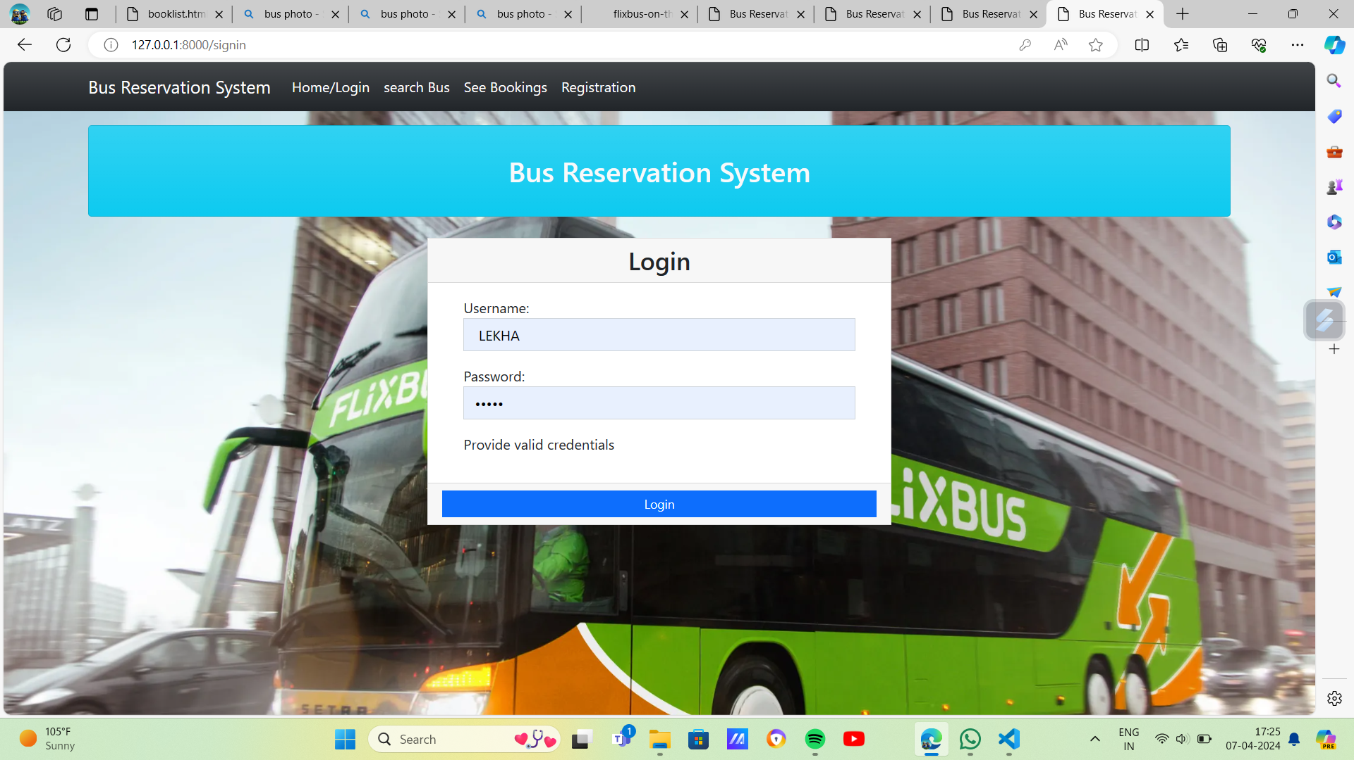
Homepage

Slide 12
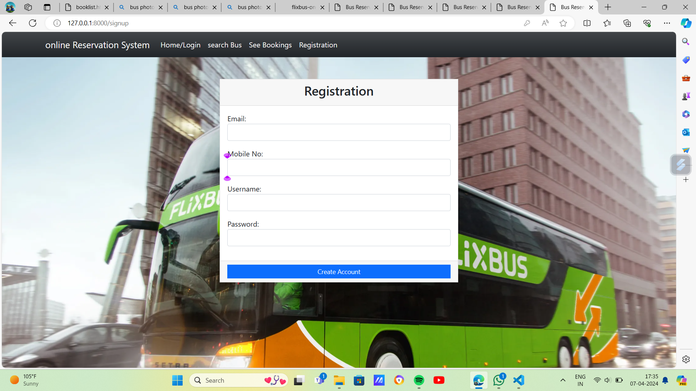
About-Us-Page

Slide 13
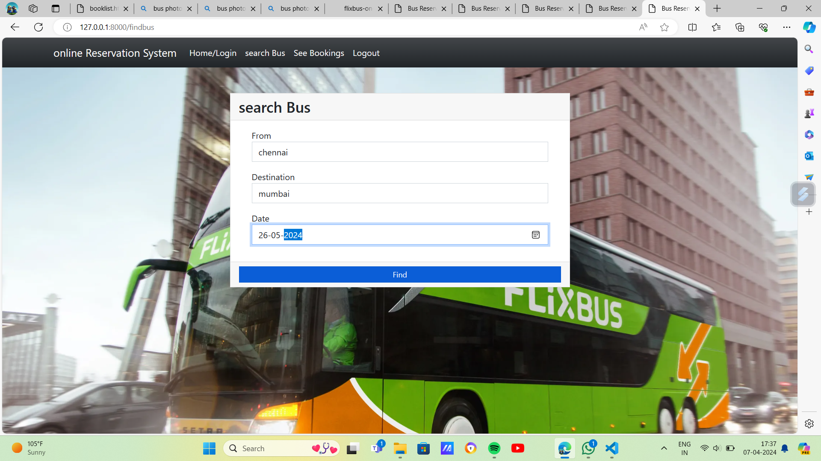
Service-Page

Slide 14
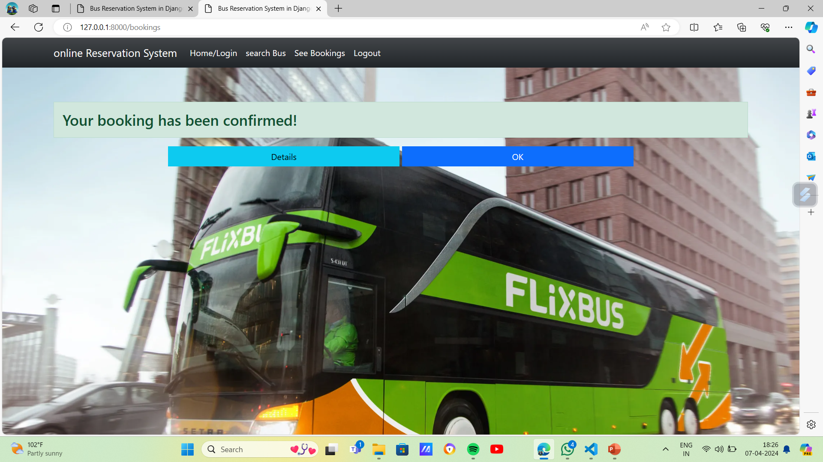
Departments-Page

Slide 15
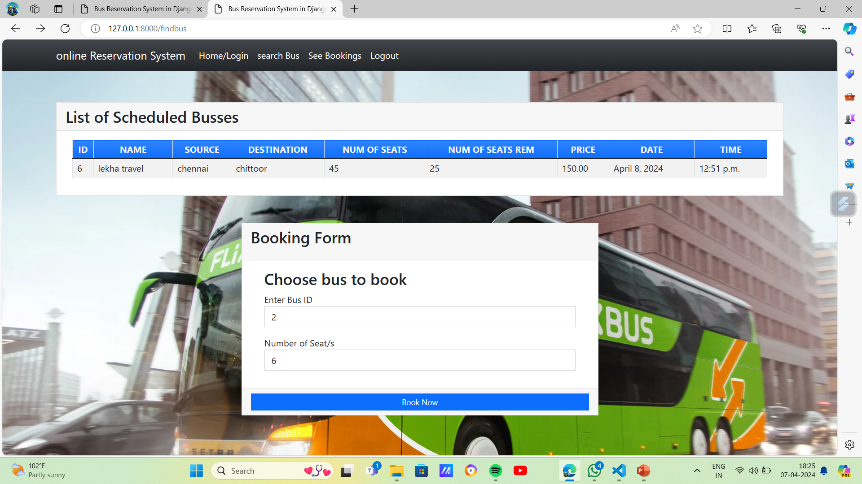
Blog-Page

Slide 16
Future Enhancements:
One potential future enhancement for bus reservation systems could be the integration of predictive analytics and artificial intelligence (AI) algorithms to optimize scheduling and pricing strategies.
By analysing historical booking data, passenger demographics, seasonal trends, and external factors such as weather conditions and events, AI-powered algorithms could forecast demand more accurately and adjust bus schedules and ticket prices dynamically.
This predictive capability would enable operators to optimize resource allocation, maximize revenue, and improve passenger satisfaction by offering competitive prices and ensuring availability on high-demand routes.
Additionally, the integration of AI-driven chatbots or virtual assistants could enhance customer support capabilities, providing passengers with instant assistance and personalized recommendations throughout the booking process.

Slide 17
Conclusion
In conclusion, bus reservations play a crucial role in modern transportation systems by providing passengers with convenient, reliable, and efficient travel options.
From the booking process to seat allocation, real-time updates, and management tools for operators, bus reservation systems streamline various aspects of bus travel, enhancing the overall passenger experience and operational efficiency.
As technology continues to evolve, future enhancements such as predictive analytics, AI-driven decision-making, and contactless ticketing solutions promise to further improve the effectiveness and convenience of bus reservations.
By embracing innovation and prioritizing customer satisfaction, bus reservation systems will continue to play a pivotal role in shaping the future of public transportation, offering sustainable and accessible mobility solutions for people around the world.
Source :

Slide 18
Thank You!
Notes:
Thank You !!

